Slide 1
Shop under attack
Krsmanovich Marko
Kasimov Ilya

Slide 2
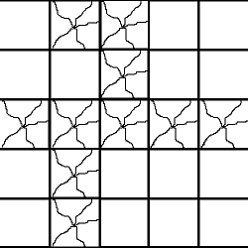
Condition

Slide 3
Two cases
1x1 * 2 <= 1x2 – obviously
1x1 * 2 <= 1x2 – needed to be investigated

Slide 4
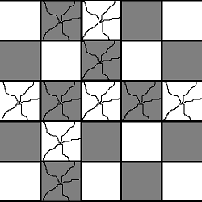
Solution

Slide 5
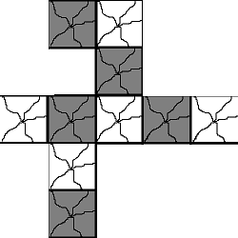

Slide 7
1
1
1
1
1
1
Source
1
1
Sink
1
1
1
1
1
1
1
1
1
1
1

Slide 8
Complexity
O(E|f|) – complexity of Ford-Fulkerson
(E – num of edges, |f| - abs.value of flow)
|f| <= (Damaged products) / 2
E <= (Damaged products) * 4
So O((Damaged products)^2)

Slide 9
Ask your questions

